Slide 1
Predicting diabetes using Machine Learning
Shehani Leon
21-11-2022

Slide 2
Content
Preparing Data
Clean & explore dataset
Graphs
Pre processing steps
Correlation/ Selecting features
Identifying solution approach
Train the model
Model evaluation

Slide 3

Preparing data
For this project I have used Pima Indians diabetes dataset in kaggle.
In this dataset, we have few details of the patient(Glucose level, BMI, age, Blood pressure etc.) considering the patterns/ correlation I have created a machine learning model to predict diabetes.
Prior using these data to train the model, we must cleanse the data first.

Slide 4
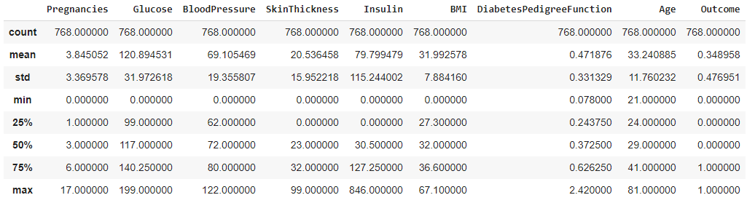
Clean & Explore the dataset
This data set contains all numeric data. I have imported the dataset and performed a descriptive analysis to explore the dataset and identify what treatments I must apply on the dataset prior using it to train the model.

Slide 5
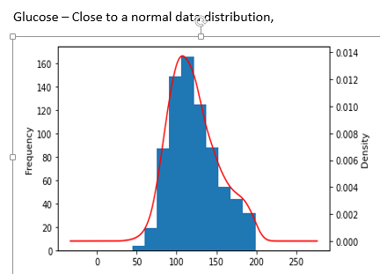
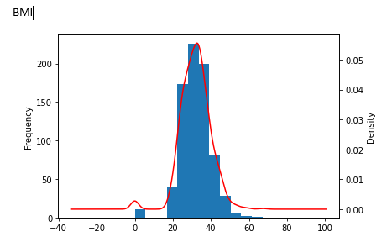
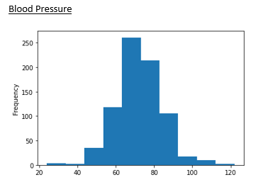
Graphs (Data Visualization)

Slide 6
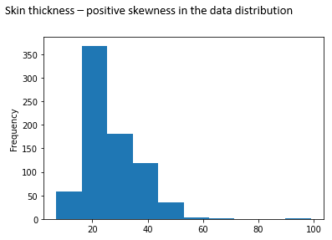
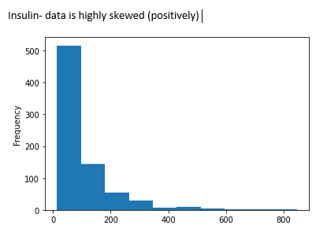
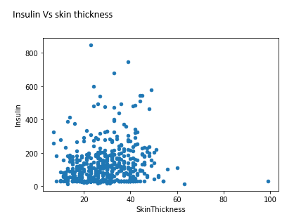
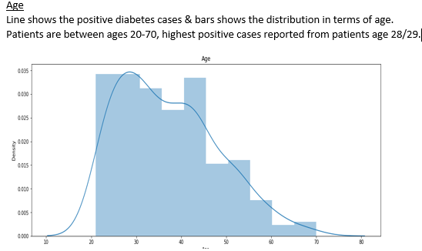
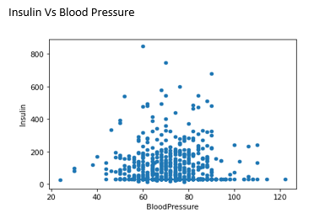

Slide 7
Pre processing step.
Checked and removed any null values.
Checked and removed any duplicating records in the dataset (if any).
As per the data plots shown in the previous slide, it is clear some of the features have outliers. In order to predict more accurately, I have decided to selected data only in IQR and removed any outliers.
Identified the dependent & independent variables and identify the correlation between. And selected the features with high correlation to train the model.
Feature = Outcome / Dependent variable (Y) (gives the result if the patient is diabetes positive or not)
Rest of the features = Independent variables (X)

Slide 8
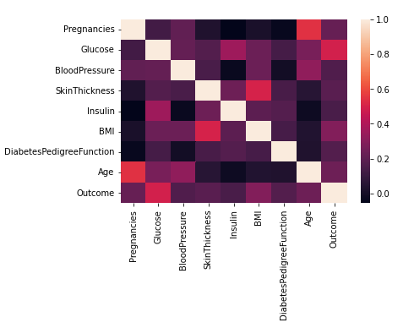
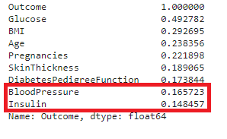
Co-relation/ Selecting features
Checked how X variables correlate with Y variables. As per the results Blood pressure & Insulin had relatively low correlation. Since these features don’t have a strong say about the fine result, I have removed these features and trained the model.

Slide 9
Identifying the solution approach.
I used supervised machine learning approach to build the model.
Since this is a Binary classification problem, I have used both logistic regression & random forest classifier model.
Based on the model performance, will be selecting the model with highest accuracy.
Train test split.
I have used the train test split function in sklearn to split the dataset to train & test the model.
I first defined the X & Y variables and used 80% of the data to train the model & 20% of it to test.

Slide 10
Model Evaluation
I have selected below functions to evaluate the model performance.
Confusion matrix
Accuracy
Precision
Recall
F1 score

Slide 11
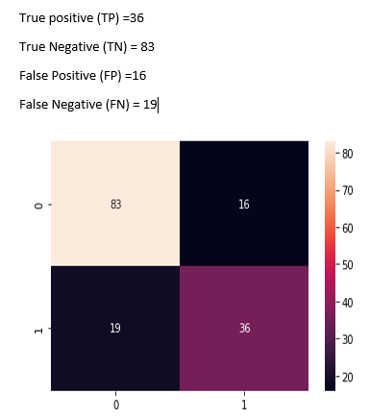
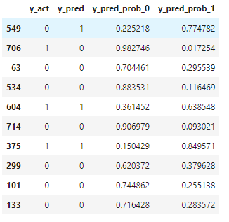
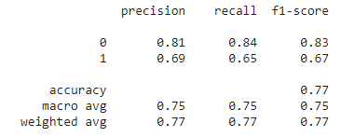
Confusion matrix & other functions
1st Model – Logistic regression
I have computed the probability of the outcome on the test data and compared this against the test actuals to evaluate the model performance, results as follows,
Predicted outcome and probability for a sample sample-:

Slide 12
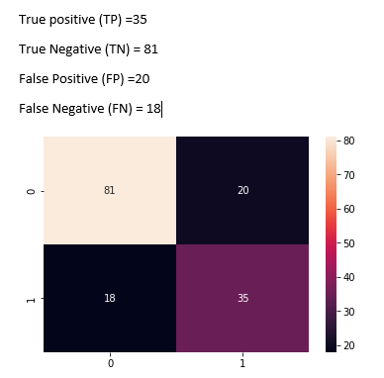
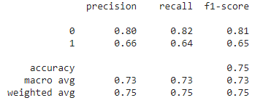
1st model Accuracy = TP+TN /(TP+TN+FP+FN) = 0.772727
Model 02- Random forest classifier
2nd model Accuracy = TP+TN /(TP+TN+FP+FN) = 0.75324

